Slide 1
BU8201 Business Finance: Tutorial 4 Risk and Rates of Return
Done by:
Yang Jing Yan
Wang Mengran
Liu Jiaqing
Te Jia Hau
Chen Xiaoyu

Slide 2
Review
Types of Risks
Stand-alone Risk (in general)
Risk Measures
Coefficient of Variation (CV)
CAPM / SML
Beta
Market Risk Premium
Expected Return ($\hat{r})$
Expected Return (𝑟 ̂)
Required Return
Portfolio Stand-alone Risk
Standard Deviation ($σ)$
Standard Deviation (𝜎)
Risk measures

Slide 3
Stand-alone risk
Is the total risk of an asset (in general)

Slide 4
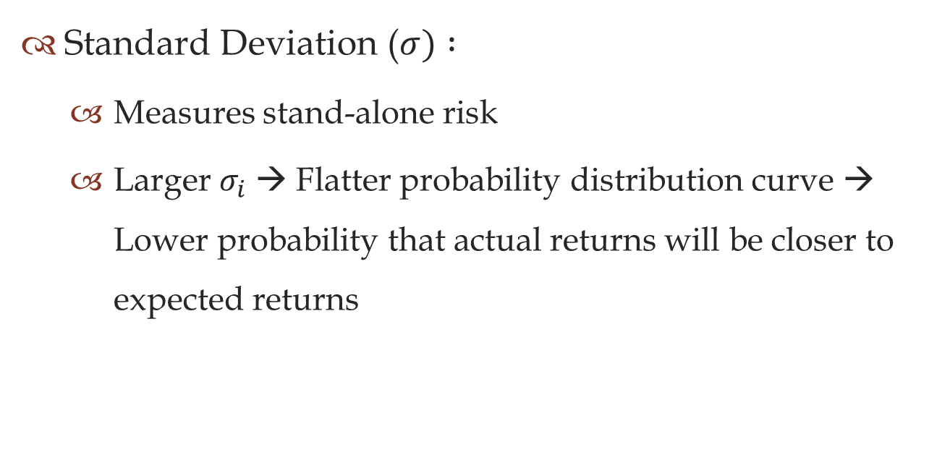
Risk Measures
Standard Deviation ($σ) :$
Measures stand-alone risk
Larger $σ_{i}$ → Flatter probability distribution curve → Lower probability that actual returns will be closer to expected returns

Slide 5
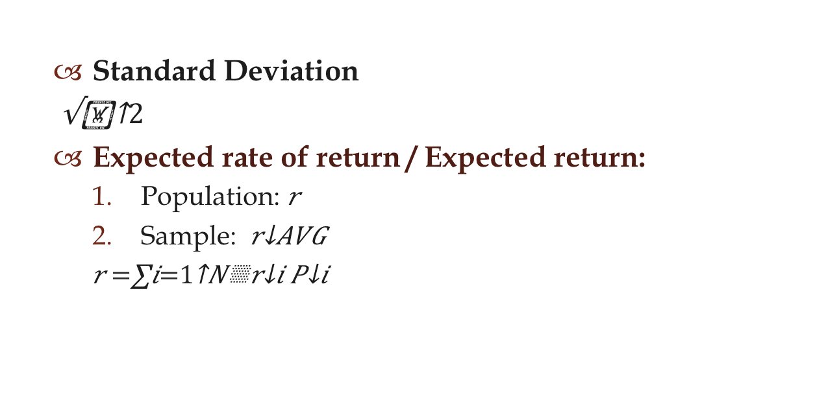
Risk Measures - Formulas
Standard Deviation
$\sqrt{{\text{}}^{2}}$
Expected rate of return / Expected return:
Population: $\hat{r}$
Sample: $\overline{r_{AVG}}$
$$\hat{r}=\sum_{i=1}^{N}{r_{i}P_{i}}$$
Probability of i scenario
Interest rate of i scenario

Slide 6

Risk Measures – Formulas
Standard Deviation ($σ$)
$For entire population:$
$$σ=\sqrt{{\sum_{i=1}^{N}{(r_{i}−\hat{r}})}^{2}P_{i}}$$
$For a sample (usually used):$
$$S_{n }= \sqrt{\frac{\sum_{i=1}^{n}{\left(\overline{r_{t}} −\overline{r_{AVG}}\right)\text{2} }}{n−1}}$$

Slide 7
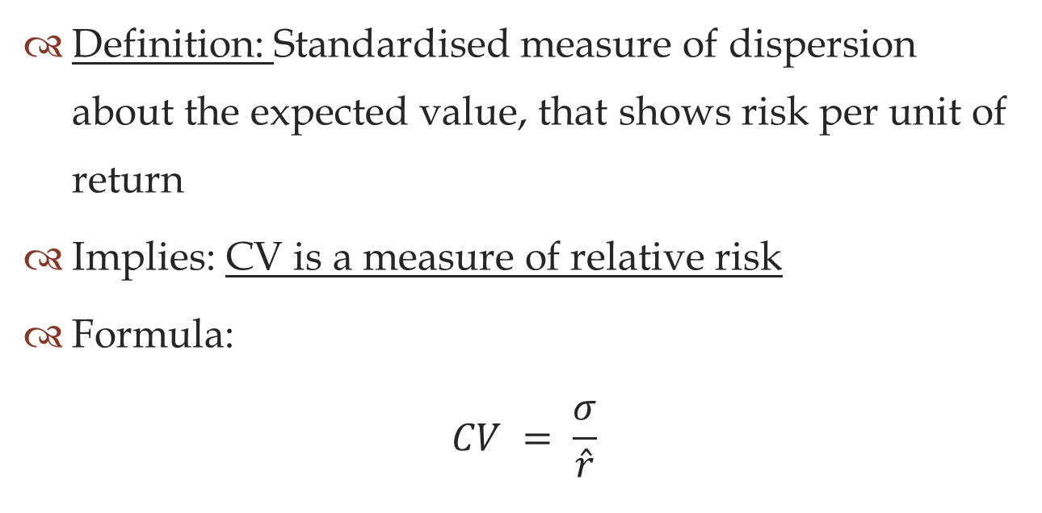
Coefficient of Variation (CV)
Definition: Standardised measure of dispersion about the expected value, that shows risk per unit of return
Implies: CV is a measure of relative risk
Formula:
$$CV = \frac{σ}{\hat{r}}$$

Slide 8
Portfolio Stand-alone Risk
Is the total risk of all the portfolio’s component assets
Simplest portfolio: 2-stock portfolio
2-stock portfolio = HT and Collections

Slide 9

Portfolio Risk Measures – Formulas
Expected return / Expected rate of return ($\hat{r_{p}} for population or \overline{r_{AVG}}$ for sample) is a weighted average:
$\hat{r_{p}} = \sum_{j=1}^{N}{w_{j}}\hat{r_{j}}$
j asset’s individual expected return
Proportion / weightage of the asset j in the portfolio’s total components assets

Slide 10


Portfolio Risk Measures – Formulas
Standard deviation of portfolio ($σ_{p})$
$For entire population:$
$$σ_{p}=\sqrt{{\sum_{i=1}^{N}{(r_{i}−}\hat{r_{p}})}^{2}P_{i}}$$
$For a sample (usually used):$
$$S_{n }= \sqrt{\frac{\sum_{i=1}^{n}{\left(\overline{r_{t}} −\overline{r_{AVG}}\right)\text{2} }}{n−1}}$$

Slide 11

Coefficient of Variation (CV) - Portfolio
Measures relative risk of portfolio
Formula:
$${CV}_{p = \frac{σ_{p}}{\hat{r_{p}}}}$$

Slide 12
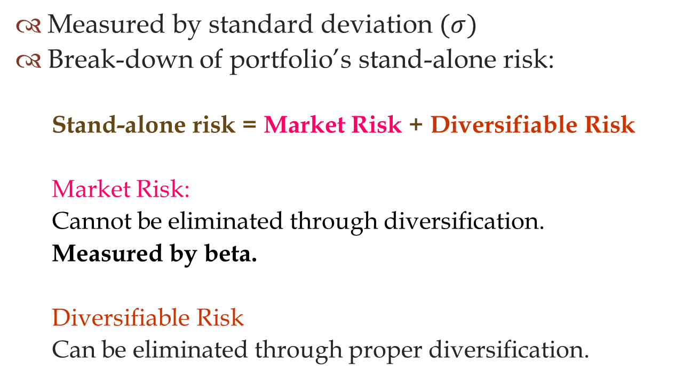
Stand-alone Risk of Portfolio
Measured by standard deviation $(σ)$
Break-down of portfolio’s stand-alone risk:
Stand-alone risk = Market Risk + Diversifiable Risk
Market Risk:
Cannot be eliminated through diversification.
Measured by beta.
Diversifiable Risk
Can be eliminated through proper diversification.

Slide 13
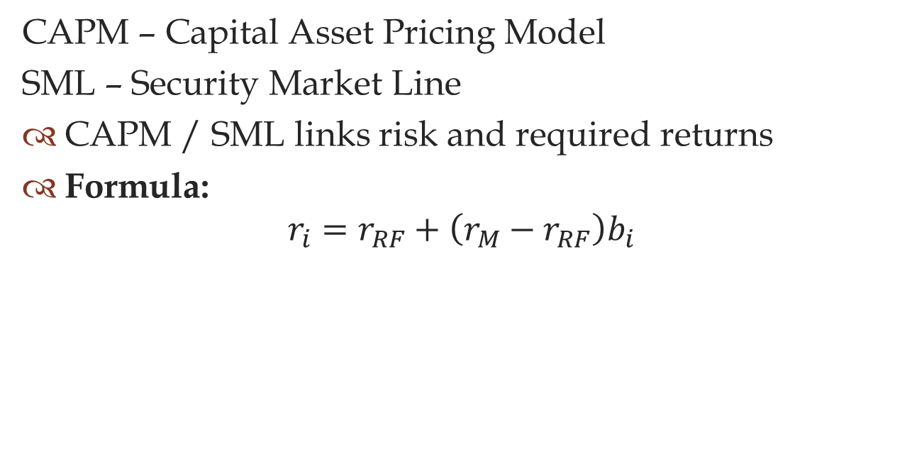
CAPM / SML
CAPM – Capital Asset Pricing Model
SML – Security Market Line
CAPM / SML links risk and required returns
Formula:
$$r_{i}=r_{RF}+\left(r_{M}−r_{RF}\right)b_{i}$$

Slide 14
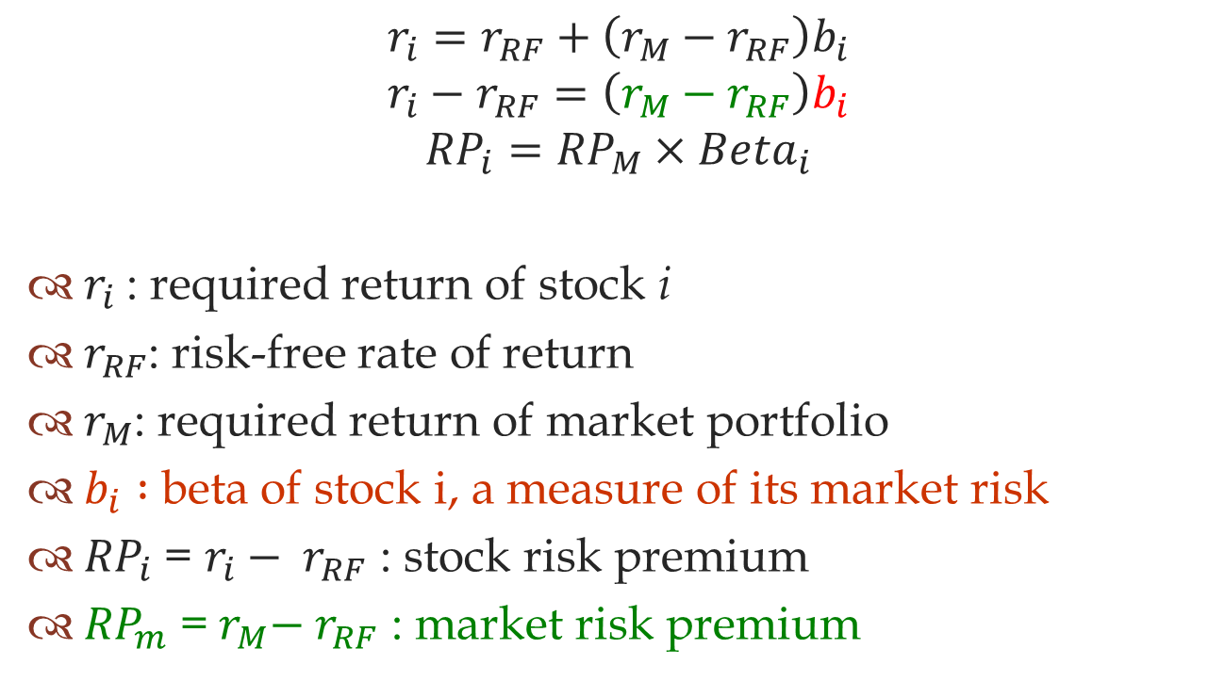
CAPM / SML
$$r_{i}=r_{RF}+\left(r_{M}−r_{RF}\right)b_{i}$$
$$r_{i}−r_{RF}=\left(r_{M}−r_{RF}\right)b_{i}$$
$${RP}_{i}={RP}_{M}×{Beta}_{i}$$
$r_{i}$: required return of stock i
$r_{RF}$: risk-free rate of return
$r_{M}$: required return of market portfolio
$b_{i} :$beta of stock i, a measure of its market risk
${RP}_{i}$ = $r_{i}− r_{RF}$ : stock risk premium
${RP}_{m}$ =${ r}_{M}−{ r}_{RF}$ : market risk premium

Slide 15
Beta
Indicates the riskiness of a stock held in a well-diversified portfolio
Larger the beta → Higher risk of stock
Larger the beta → Higher sensitivity of stock to movement in market return rates

Slide 16
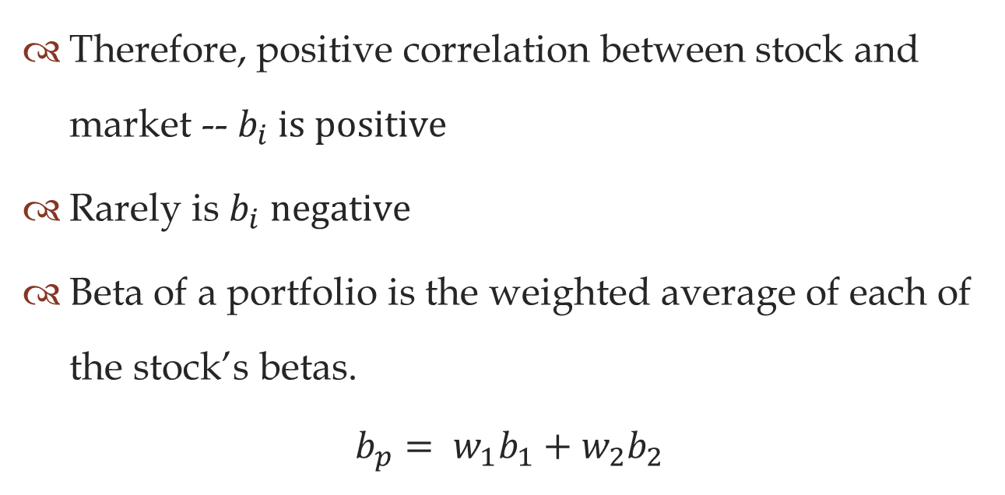
Beta
Therefore, positive correlation between stock and market -- $b_{i} is positive$
Rarely is $b_{i} negative$
Beta of a portfolio is the weighted average of each of the stock’s betas.
$$b_{p}= w_{1}b_{1}+w_{2}b_{2}$$

Slide 17
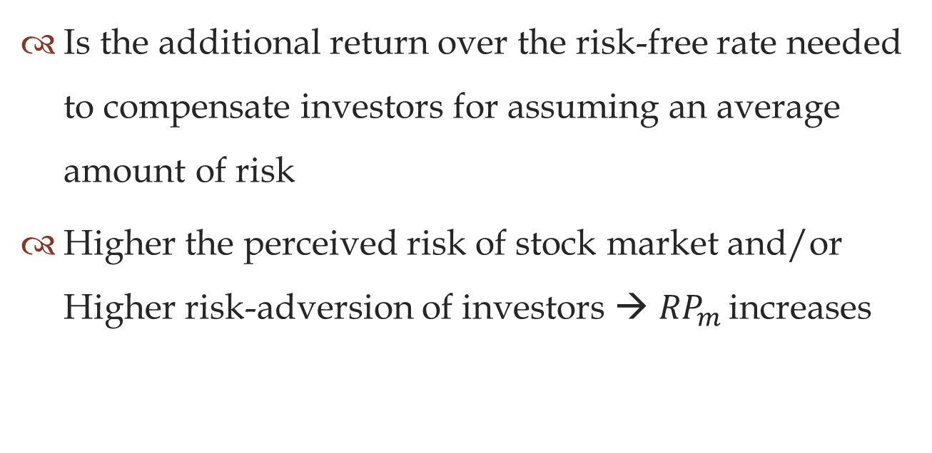
Market Risk Premium
Is the additional return over the risk-free rate needed to compensate investors for assuming an average amount of risk
Higher the perceived risk of stock market and/or Higher risk-adversion of investors → ${RP}_{m }$increases

Slide 18
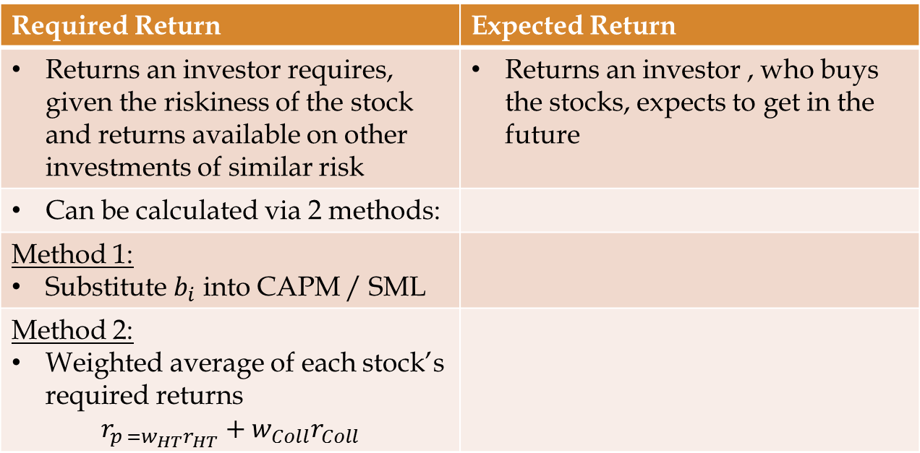
Required Return VS Expected Return
Required Return | Expected Return
Returns an investor requires, given the riskiness of the stock and returns available on other investments of similar risk | Returns an investor , who buys the stocks, expects to get in the future
Can be calculated via 2 methods:
Method 1: Substitute $b_{i}$ into CAPM / SML
Method 2: Weighted average of each stock’s required returns $$r_{p =w_{HT}r_{HT}}+w_{Coll}r_{Coll}$$

Slide 19
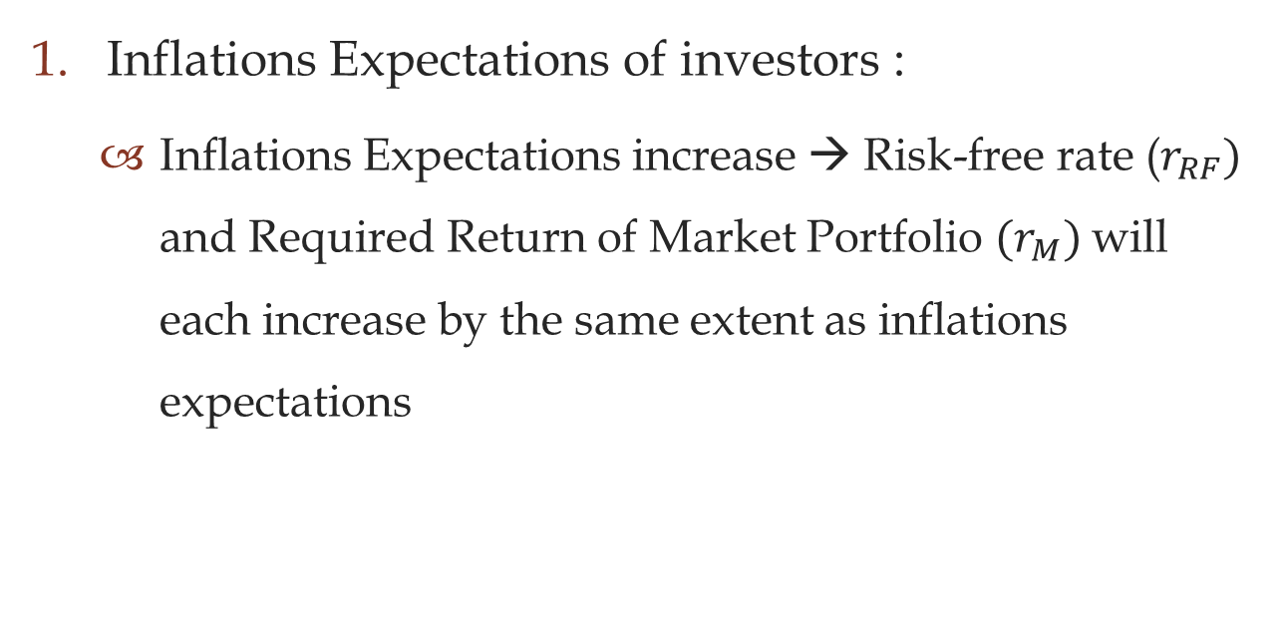
Factors affecting SML
Inflations Expectations of investors :
Inflations Expectations increase → Risk-free rate ($r_{RF})$ and Required Return of Market Portfolio ${(r}_{M})$will each increase by the same extent as inflations expectations

Slide 20
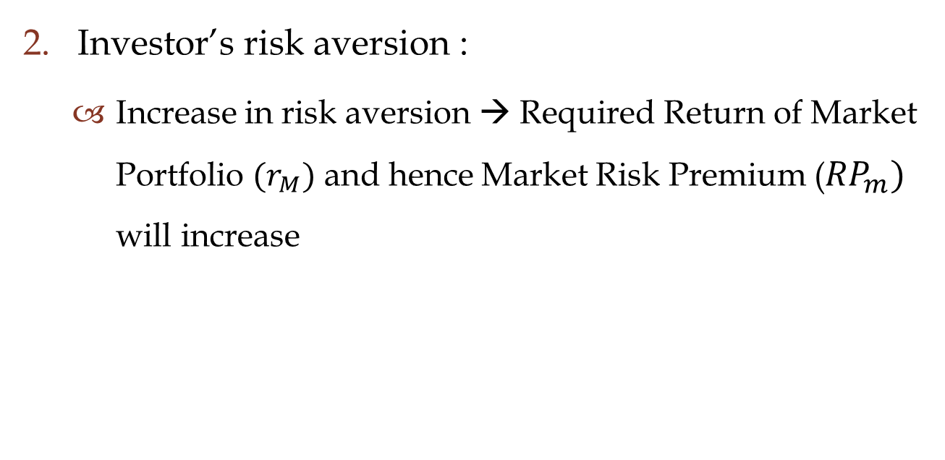
Factors affecting SML
Investor’s risk aversion :
Increase in risk aversion → Required Return of Market Portfolio ${(r}_{M})$ and hence Market Risk Premium (${RP}_{m})$ will increase

Slide 21
Tutorial Questions Q7-7 & Q7-8
Wang Mengran

Slide 22
Q7-7 If investors’ aversion to risk increased, would the risk premium on a high-beta stock increase by more or less than that on a low-beta stock? Explain!
Risk aversion: “assumes investors dislike risk and require higher rates of return to encourage them to hold riskier securities.” _{(Slide p.g. 4-19)}
Risk premium : “…serves as compensation for investors to hold riskier securities.” ₍₄₋₁₉₎
Beta: indicates how risky a stock is if the stock is held in a well-diversified portfolio. ₍₄₋₃₅₎

Slide 23
Stock risk premium (RP_{i}) = beta× Market risk premium (RP_{m}) ₍₄₋₃₄₎
“Market risk premium (RP_{m}) increases if the investors’ degree of risk aversion increases. “ ₍₄₋₄₃₎
Thus, given the same increase in Market risk premium (RP_{m,}): higher beta =>higher stock risk premium (RP_{i})
Answer
Risk premium of high beta-stock will increase MORE than a low-beta stock.

Slide 24

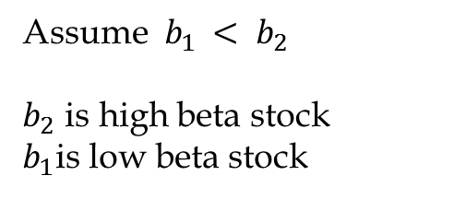


Assume $b_{1 }< b_{2}$
$b_{2}$ is high beta stock
$b_{1}$is low beta stock
r
$${SML}_{2}\left(b_{2}\right)$$
$${SML}_{1}\left(b_{1}\right)$$
$$r_{RF}$$
b

Slide 25
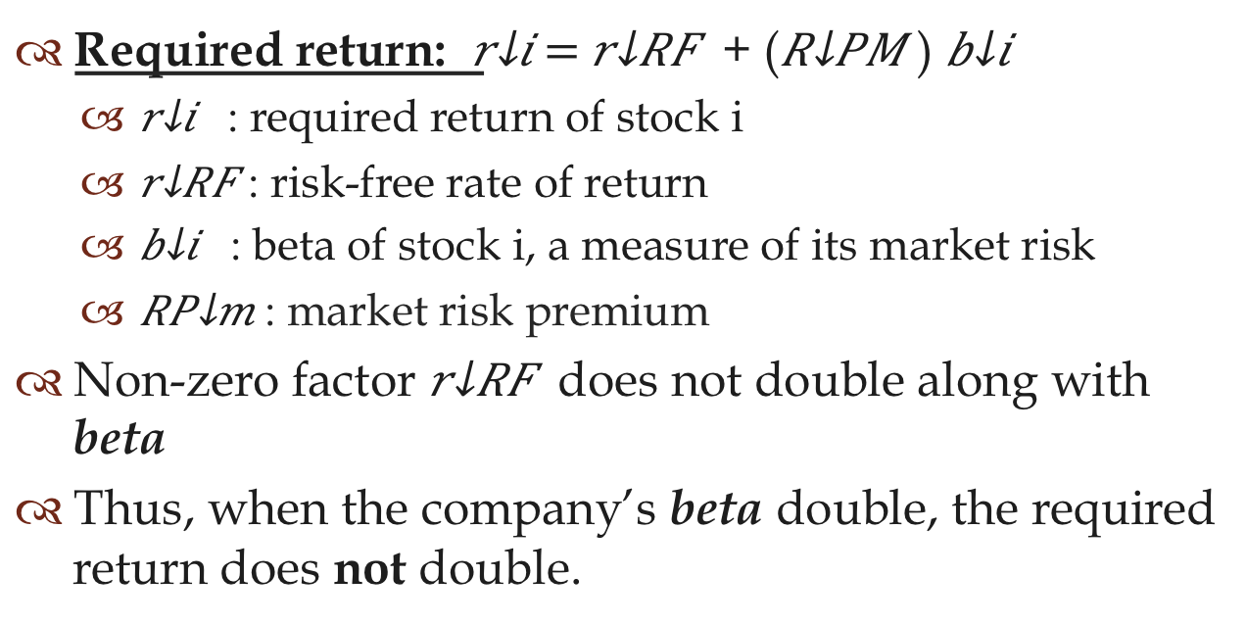
Q7-8 If a company’s beta were to double, would its required return also double?
Required return: $r_{i}= r_{RF}$ + ($R_{PM}$) $b_{i}$
$r_{i}$ : required return of stock i
$r_{RF}$: risk-free rate of return
$b_{i}$ : beta of stock i, a measure of its market risk
${RP}_{m}$: market risk premium
Non-zero factor $r_{RF}$does not double along with beta
Thus, when the company’s beta double, the required return does not double.
Answer: No

Slide 26
Tutorial Questions P7-6 & P7-12
Liu Jiaqing

Slide 27
P7-6 Expected Returns
Is it reasonable that diversified investors regard Stock Y (which has higher standard deviation of return and CV than Stock X) as being less risky than Stock X? Explain.
Ans: Yes, it is reasonable when beta of Stock Y is less than beta of Stock X.

Slide 28

Analysis:
Since$σix<σiy$ & $CVx<CVy$
Lower probability that actual returns will be closer to expected return
Curve of Stock Y is flatter
Stock Y is
Risker
However, Standard deviation measures total, or stand-alone risk
Stand-Alone Risk: The risk an investor would face if he or she held only one asset

Slide 29
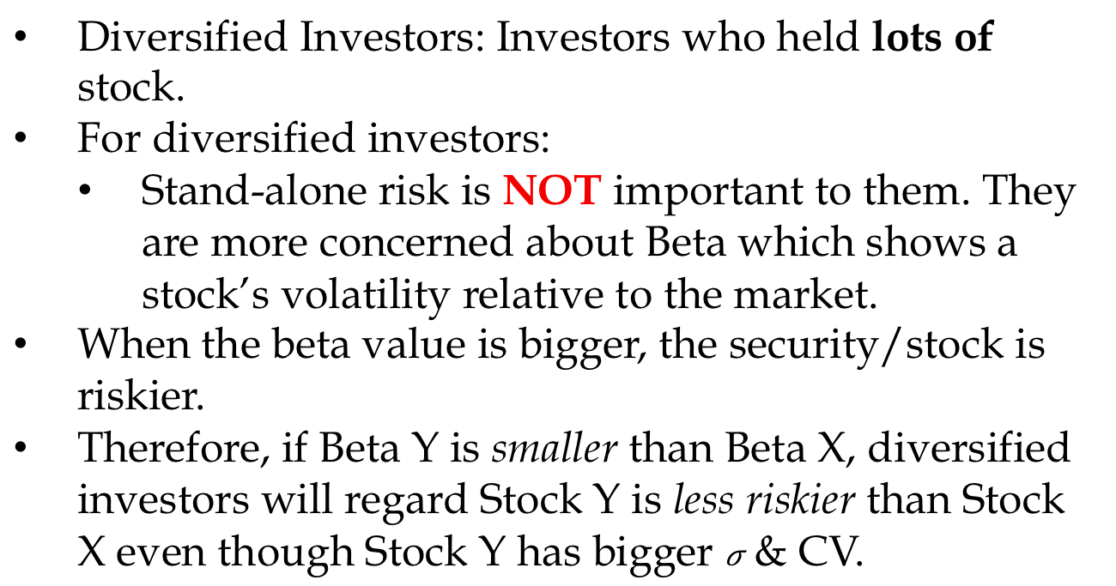
Diversified Investors: Investors who held lots of stock.
For diversified investors:
Stand-alone risk is NOT important to them. They are more concerned about Beta which shows a stock’s volatility relative to the market.
When the beta value is bigger, the security/stock is riskier.
Therefore, if Beta Y is smaller than Beta X, diversified investors will regard Stock Y is less riskier than Stock X even though Stock Y has bigger $σ$ & CV.

Slide 30
P7-6 CAPM and required return
Calculate the required rate of return for Manning Enterprises, assuming that investors expect a 3.5 percent rate of inflation in the future. The real risk-free rate is 2.5 percent and the market risk premium is 6.5 percent. Manning has a beta of 1.7 and its realized rate of return has averaged 13.5 percent over the past 5 years.

Slide 31
Ans:
Formula:
Obtain the useful information:
ri = rRF + (rM-rRF) bi
ri = rRF + (RPm) bi
rRF = r*+ IP
Expected Inflation Rate: IP= 3.5%
Real Risk-free Rate: r*=2.5%
Market Risk Premium: RPm=6.5%
Beta=1.7
ri = rRF + (rM-rRF) bi
= r*+ IP + (RPm) bi
= 2.5% + 3.5% + 6.5%*1.7
= 17.05%
The required rate of return is 17.05%

Slide 32




r
$${SML}_{2}\left({IP}_{1, }b_{1 }\right)$$
²
$${SML}_{1}\left(b_{1}\right)$$
$$r_{RF}^{}$$
$$r_{RF}^{}$$
¹
b

Slide 33
Tutorial Questions P7-16 & P7-17
Te Jia Hau

Slide 34
P7-16 Portfolio beta
Suppose you held a diversified portfolio consisting of a $7,500 investment in each of 20 different common stocks. The portfolio’s beta is 1.12. Now suppose you decided to sell one of the stocks in your portfolio with a beta of 1.0 for $7500 and to use these proceeds to buy another stock with a beta of 1.75. What would your portfolio’s new beta be?

Slide 35
Summary
Given:
Starting portfolio beta, b_{p} = 1.12
w_{i} = 1/20
∑ b_{i} = 20 X 1.12 = 22.4
beta of the sold stock, b_{ss} = 1.0
beta of the bought stock, b_{bs} = 1.75
So, what is the beta of the new portfolio ?

Slide 36
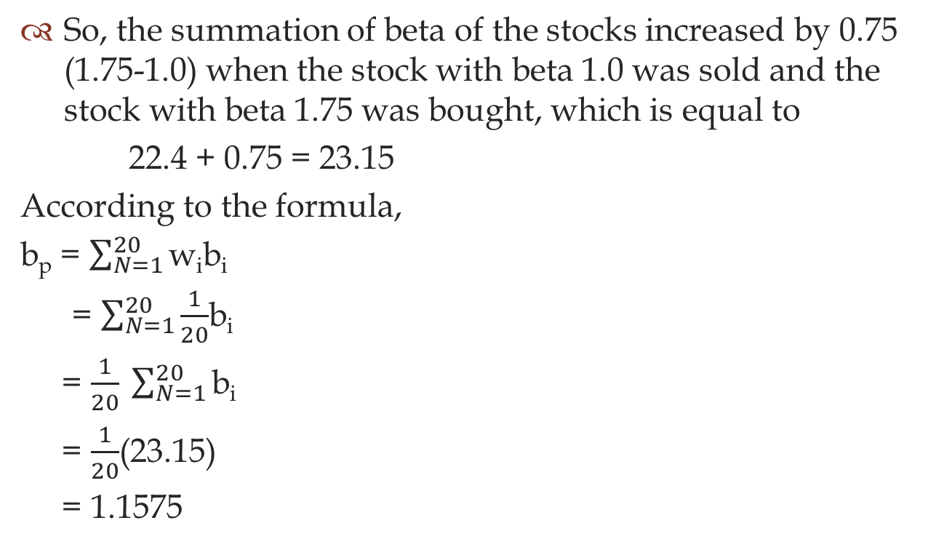
Solution
So, the summation of beta of the stocks increased by 0.75 (1.75-1.0) when the stock with beta 1.0 was sold and the stock with beta 1.75 was bought, which is equal to
22.4 + 0.75 = 23.15
According to the formula,
b_{p} = $\sum_{N=1}^{20}{\text{w}\text{i}\text{b}\text{i} }$
= $\sum_{N=1}^{20}{\frac{1}{20}}$b_{i}
= $\frac{1}{20} \sum_{N=1}^{20}{\text{b}\text{i} }$
= $\frac{1}{20}$(23.15)
= 1.1575

Slide 37





Alternative Solution
$$1.12 = \left(0.05×1\right)+0.05b_{1}$$
$$0.95b_{1}=1.07$$
$$b_{1}=1.126$$
$b_{p}=$ ($1.126×0.95)+(1.75 ×0.05)$
$b_{1}=1.15$72

Slide 38
P7-17 CAPM and required return
HR Industries (HRI) has a beta of 1.8, while LR Industries (LRI)’s beta is 0.6. The risk-free rate is 6 percent, and the required rate of return on an average stock is 13 percent. Now the expected rate of inflation build into r_{RF} falls by 1.5 percentage points, the real risk-free rate remains constant, the required return on the market falls to 10.5 percent, and all betas remain constant. After all of these changes, what will be the difference in the required returns for HRI and LRI?

Slide 39
Summary
Formula: r_{i} = r_{RF}+ ( r_{m}- r_{RF}) b_{i}
Given:
Beta of HRI(b_{HRI}) = 1.8
Beta of LRI(b_{LRI}) = 0.6
Risk free rate (r_{RF} )= 6%-1.5%= 4.5%
Required return of the market: r_{M} = 10.5%
So, what is difference between the required returns for HRI and LRI?
r_{HRI} -r_{LRI} = ???

Slide 40
Solution
Use the formula
r_{i} = r_{RF}+ ( r_{m}- r_{RF}) b_{i}
r_{HRI} = 4.5%+(10.5%-4.5%)X1.8
=15.3%
r_{LRI} = 4.5%+(10.5%-4.5%)X0.6
= 8.1%
r_{HRI} -r_{LRI} =15.3%-8.1%=7.2%
So, the difference between the required returns for HRI and LRI is 7.2%

Slide 41
Tutorial Questions P7-18 & P7-19
Chen Xiaoyu

Slide 42
P7-18 CAPM and Portfolio Return
You have been managing a $5 million portfolio that has a beta of 1.25 and a required rate of return of 12 percent. The current risk-free rate is 5.25 percent. Assume that you receive another $500,000. If you invest the money in a stock with a beta of 0.75, what will the required return on your $5.5 million portfolio?

Slide 43
P7-18 CAPM and Portfolio Return
Summary:
P1 beta (b_{p1}) = 1.25
Required rate of return (r_{p1}) = 12%
Risk free rate (r_{RF} )= 5.25%
New investment beta (b_{p2} )= 0.75
? : Required rate of return (r_{p})

Slide 44
P7-18 CAPM and Portfolio Return
Formula :
r_{p}= r_{RF} + (RP_{m})(b_{p})
First, find the beta of the new portfolio (b_{p}).
b_{p}=w_{p1}b_{p1} + w_{p2}b_{p2}
b_{p}=(5.0/5.5)(1.25) + (0.5/5.5)(0.75)
b_{p} =1.2045

Slide 45
P7-18 CAPM and Portfolio Return
Then, find the market risk premium,
r_{p1}= r_{RF} + (RP_{m})(b_{p1})
12% = 5.25% + RP_{M} ×1.25
RP_{M}=5.4%
Finally, required return of the $5.5 million portfolio is :
r_{p2}= r_{RF} + (RP_{m})(b_{p})
r_{p2}= 5.25% + (5.4%)(1.2045)
r_{p2}= 11.7543%
Thus, the required return on $5.5 million portfolio
is 11.7543%

Slide 46
P7-19 Portfolio beta
A mutual fund manager has a $20,000,000 portfolio with a beta of 1.5. The risk-free rate is 4.5 percent and the market risk premium is 5.5 percent. The manager expects to receive an additional $5,000,000, which she plans to invest in a number of stocks. After investing the additional funds, she wants the fund’s required return to be 13 percent. What should be the average beta of the new stocks added to the portfolio?

Slide 47
P7-19 Portfolio beta
Summary:
Beta(b_{p1}) = 1.5
Risk free rate (r_{RF} )= 4.5%
Market risk premium (RP_{m})= 5.5%
Total required rate of return(r_{p} )= 13%
? : Beta of the new stock(b_{p2})

Slide 48
P7-19 Portfolio beta
Formula :
r_{p}= r_{RF} + (RP_{m})(b_{p})
First, find total beta b_{p}
r_{p}= r_{RF} + (RP_{m})(b_{p})
13%= 4.5% + (5.5%)(b_{p})
b_{p}= 1.5455

Slide 49
P7-19 Portfolio beta
Finally, calculate beta of new stock:
b_{p}=w_{p1} b_{p1} + w_{p2}b_{p2}
1.545= (20/25)(1.5)+ (5/25)(b_{p2})
b_{p2}=1.7275
Thus, the average beta of the new stocks is 1.7275

Slide 50
Q & A
Thank You !

